Slide 1
Local Search
CHAPTER 4
Oliver Schulte
Summer 2011

Slide 2
Outline
Hill-Climbing
Gradient Descent
2nd-order methods.

Slide 3
Environment Type Discussed In this Lecture
Fully Observable
Static Environment
yes
Deterministic
yes
Sequential
yes
no
Discrete
no
yes
Discrete
no
yes
Planning, heuristic search
Control, cybernetics
Vector Search: Constraint Satisfaction
Continuous Function Optimization
CMPT 310 - Blind Search
Notes:
Discuss discrete variables a little bit.

Slide 4
Optimization Problems
An optimization problem is of the form
maximize f(x) subject to constraints on x
where x is a vector of values.
Equivalently
minimize -f(x) subject to constraints on x
If the constraints are linear (in)equalities, we have a linear programming problem.
Very large literature built up over centuries.

Slide 5
AI examples
Find the right angle of joints for pancake-flipping robots.
Find the best weights for rules for reasoning.
Basically, any problem with continuous variables at some point needs optimization to build the best agent.

Slide 6
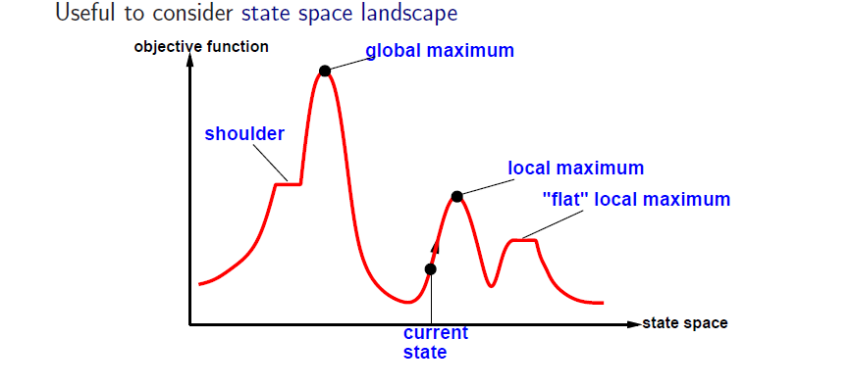
Hill-climbing search
Random-restart hill climbing over comes local maxima- Trivially complete
Random Sideways move: escapes from shoulders, loops on flat maxima.
Simple Video
Notes:
Complete because with probability 1 tries best solution.

Slide 7
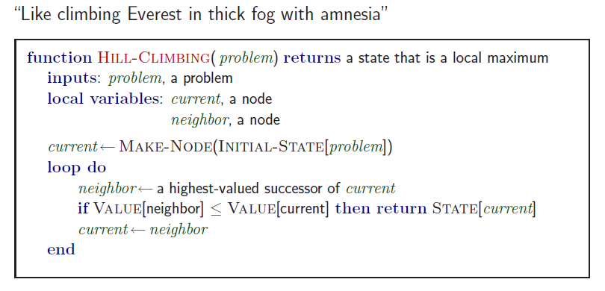
Hill-climbing search

Slide 8
Example (discrete): n-queens
Put n queens on an n × n board with no two queens on the same row, column, or diagonal
Demo for n-Queens Hill-Climbing

Slide 9

Hill-climbing search: 8-queens problem
h = number of pairs of queens that are attacking each other, either directly or indirectly
h = 17 for the above state
Notes:
h is the min-conflicts function, see text.

Slide 10

Hill-climbing search: 8-queens problem
A local minimum with h = 1

Slide 11
Gradient Descent: Choosing a direction.
Intuition: think about trying to find street number 1000 on a block. You stop and see that you are at number 100. Which direction should you go, left or right?
You initially check every 50 houses or so where you are. What happens when you get closer to the goal 1000?
The fly and the window: the fly sees that the wall is darker, so the light gradient goes down: bad direction.

Slide 12
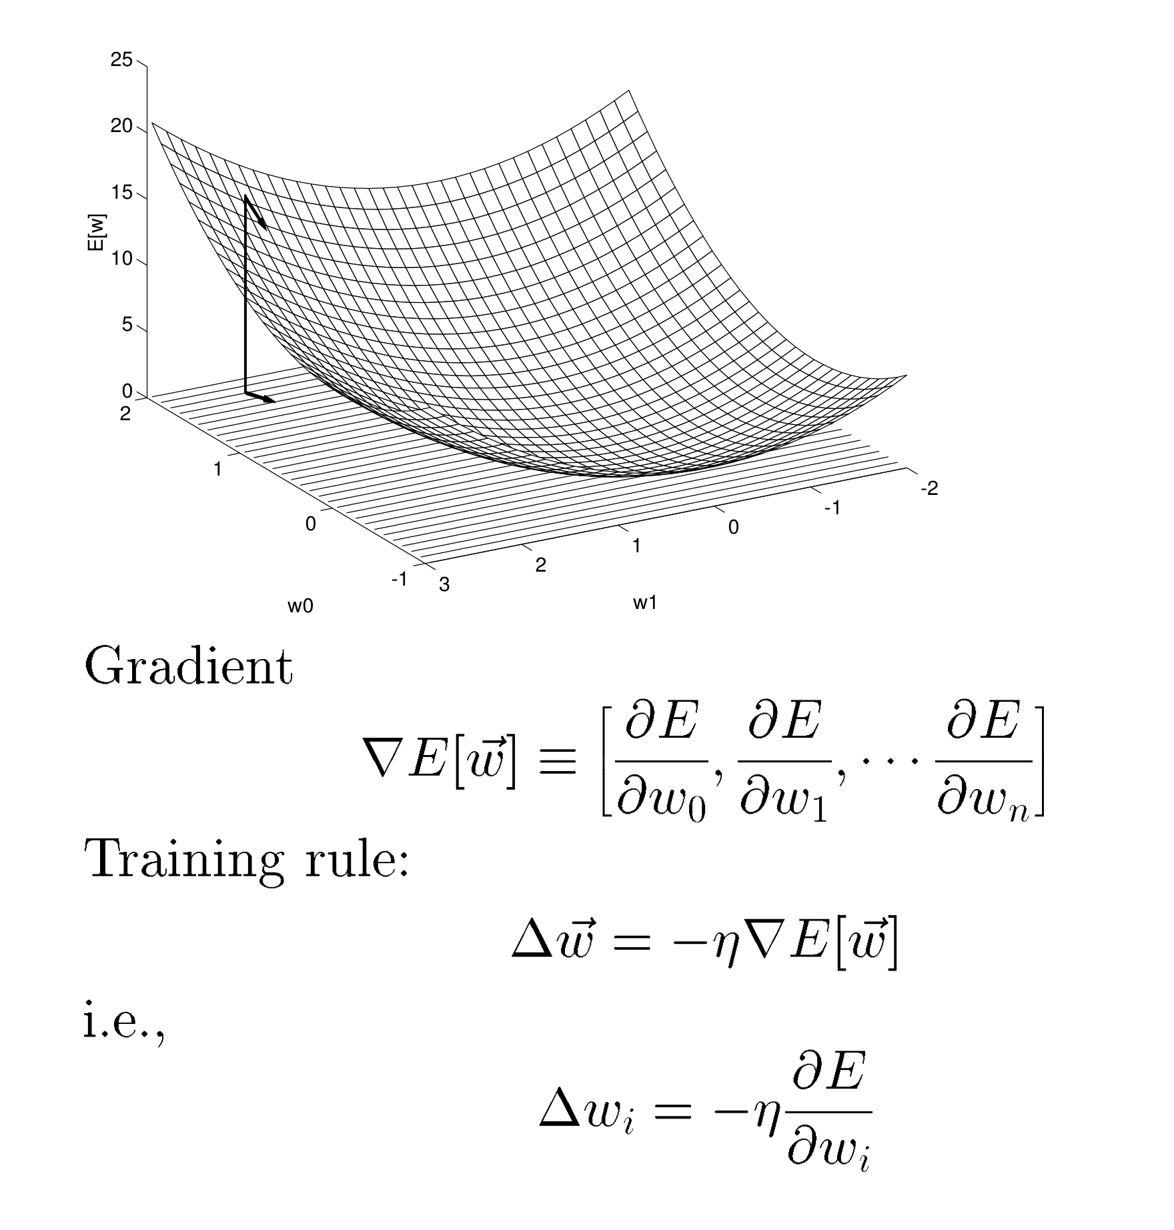
Gradient Descent In Multiple Dimensions
Demo Wolfram Stochastic Version

Slide 13
Gradient Descent: Example.
Try to find x,y that minimize
f(x,y) = 3x + y^{2.}
Your current location is x = 10, y = -3.
What is ? ?
Answer: the gradient vector is (3, 2y).
Evaluated at the location (10,-3), the gradient is ∇= (3, -6).
To minimize, we move in the opposite direction -∇.
Letting the step size η= 1, your new location is
(10,-3) - (3,-6) = (7, 3).
Excel Demo

Slide 14
Better Approach: Newton-Raphson
Uses information about second-order derivatives.
Over 300 years old.
Problem: find a root x such that g(x) = 0.
Use update rule.
x := x - g(x)/g'(x).
Geometry: fit a line (tangent) to g(x), move to intersection with x-axis.
Demo in 1 Dimension

Slide 15
Newton-Raphson for Optimization
Want to find root of derivative:
f'(z) = 0.
NR update rule then becomes.
z := z - f'(z)/f''(z).
In our example with
f(x,y) = 3x + y²
there is no curvature in the x-dimension, so we use NR only in the second dimension with
So the new location is (10,-3) - (3, -6/2) = (7,0).
You can use NR with step sizes, but the method doesn’t require it.
Change in Assignment 2: use the method without step sizes.

Slide 16
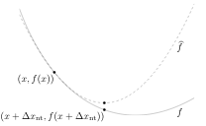
Newton-Raphson Geometry
NR fits a quadratic function to the current location, then moves to the minimum of the quadratic.
For more discussion and a picture see Wikipedia

Slide 17
Optimization Problems for Local Search
As we get close to the minimum, a fixed step size can keep over/undershooting (oscillation).
  See gradient descent example.
  Simple solution: decrease step size with number of steps taken.
No explicit goal statement – we don’t know when minimum has been reached.
  Simple solution: stop searching when “not enough” progress has been made in the “last few” iterations.
  These are user-defined parameters.

Slide 18
Refinements
Many more strategies are used.
Conjugate gradient descent: leave 0 gradient directions alone.
Add probabilistic moves to avoid/escape from local minima (the fly again!).
  Random Restart.
  Stochastic Gradient Descent.
  Simulated Annealing (gradually reduce randomness).
  Genetic Algorithms (mutations).
Try searching different locations (beam search).
Learn during searching (tabu search).

Slide 19
Summary
Greedy or Hill-Climbing Search: make local modifications to current state to find optimum.
Use gradient information to find search direction.
Main problem: get stuck in local optimum.
Other problem: can be slow in high-dimensional spaces.
Remember slow exploration of randomly moving robot.
2nd-order information speeds convergence.

